Slide 1


LNJ Bhilwara – Internal Training Material – IS & LM Cell – Version 1

Slide 2

LNJ Bhilwara – Internal Training Material – IS & LM Cell – Version 1

Slide 3

LNJ Bhilwara – Internal Training Material – IS & LM Cell – Version 1

Slide 4
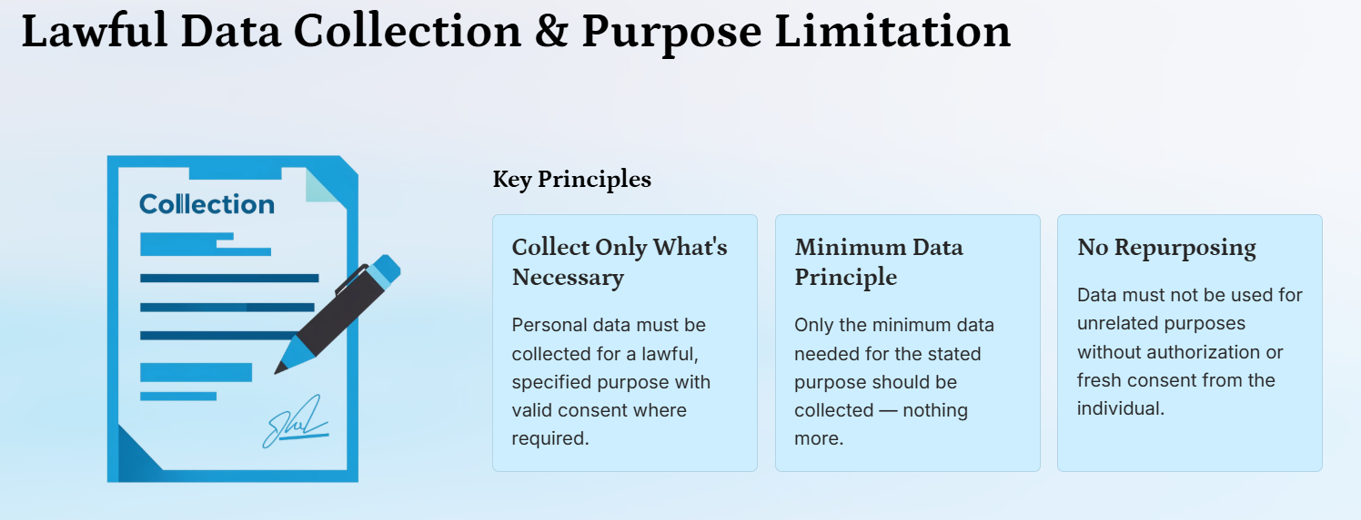
LNJ Bhilwara – Internal Training Material – IS & LM Cell – Version 1

Slide 5
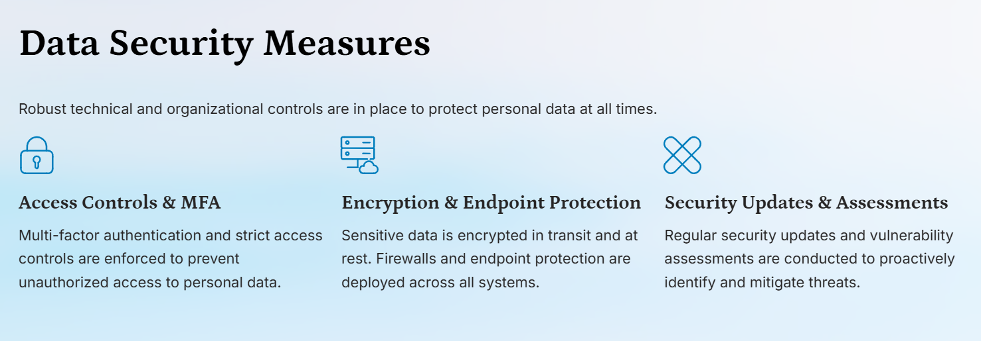
LNJ Bhilwara – Internal Training Material – IS & LM Cell – Version 1

Slide 6
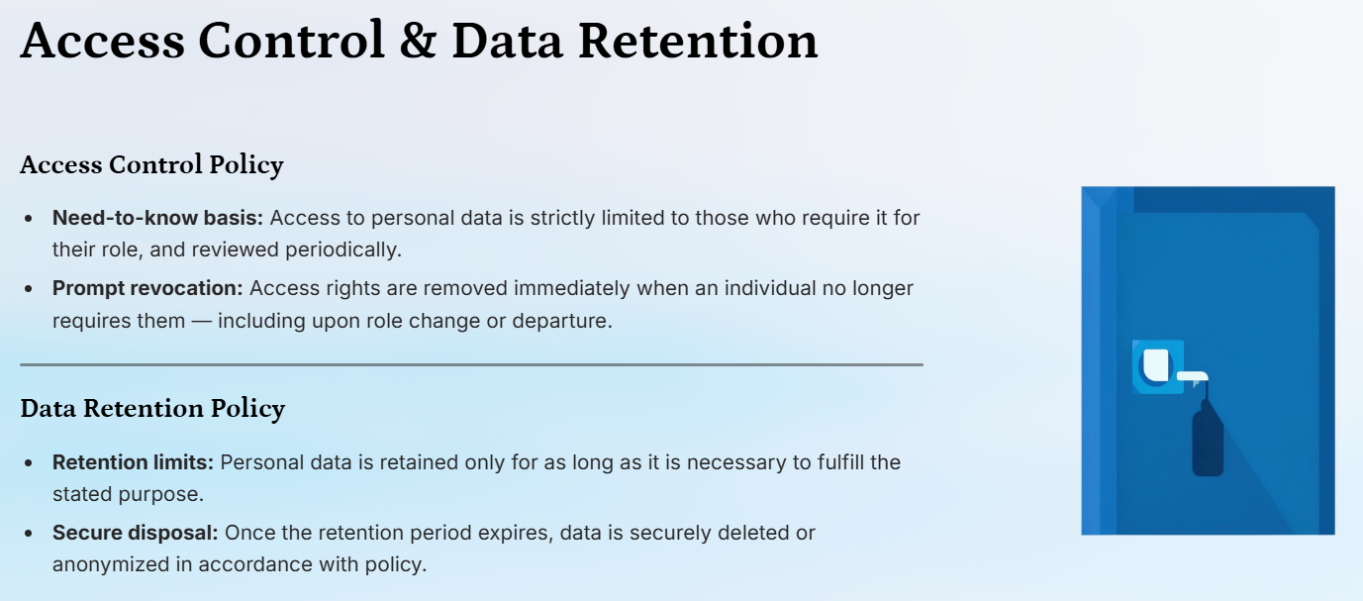
LNJ Bhilwara – Internal Training Material – IS & LM Cell – Version 1

Slide 7
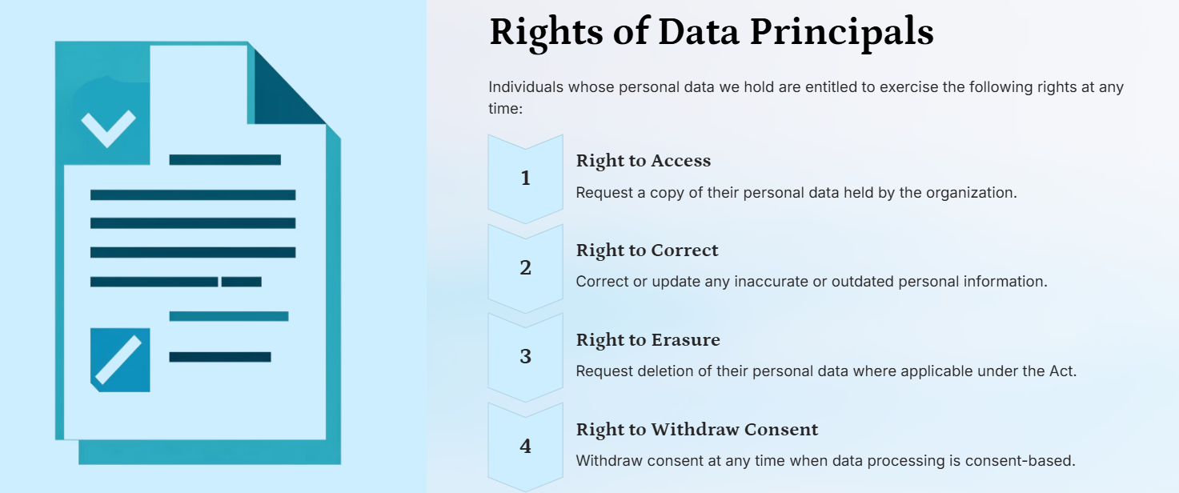
LNJ Bhilwara – Internal Training Material – IS & LM Cell – Version 1

Slide 8

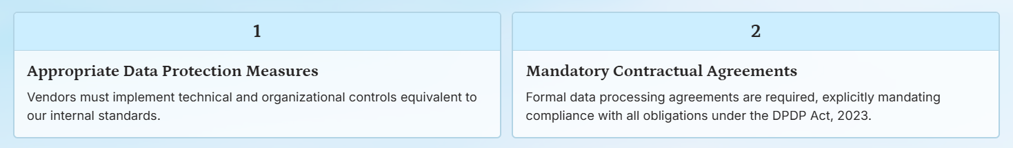
LNJ Bhilwara – Internal Training Material – IS & LM Cell – Version 1

Slide 9

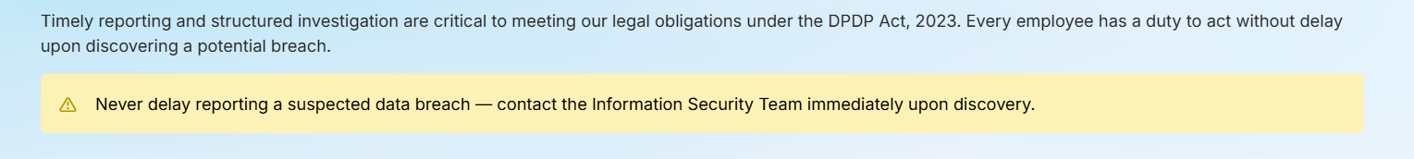
LNJ Bhilwara – Internal Training Material – IS & LM Cell – Version 1

Slide 10

LNJ Bhilwara – Internal Training Material – IS & LM Cell – Version 1

Slide 11

LNJ Bhilwara – Internal Training Material – IS & LM Cell – Version 1

Slide 12

LNJ Bhilwara – Internal Training Material – IS & LM Cell – Version 1

Slide 13
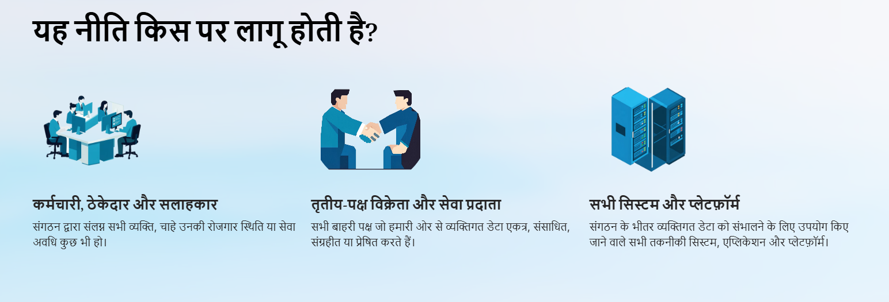
LNJ Bhilwara – Internal Training Material – IS & LM Cell – Version 1

Slide 14
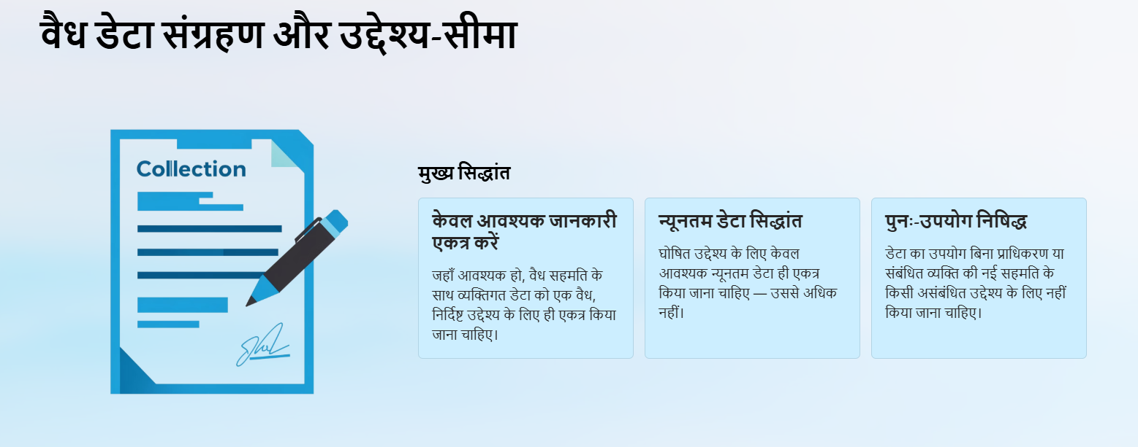
LNJ Bhilwara – Internal Training Material – IS & LM Cell – Version 1

Slide 15
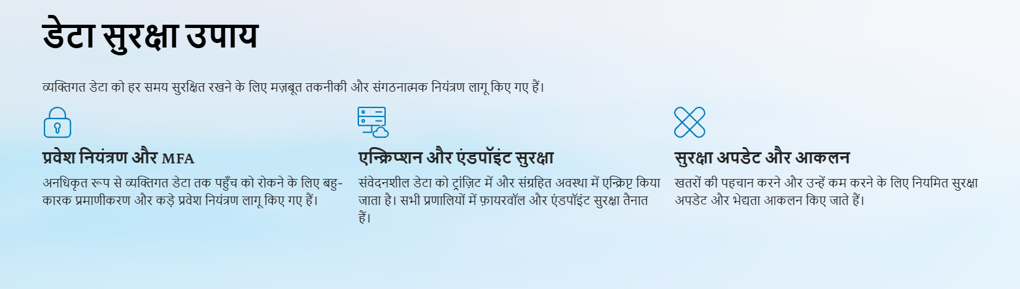
LNJ Bhilwara – Internal Training Material – IS & LM Cell – Version 1

Slide 16
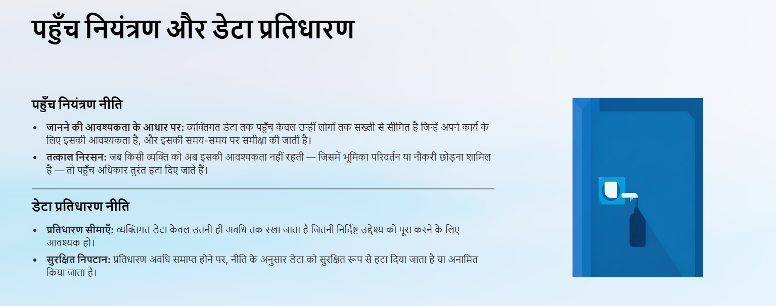
LNJ Bhilwara – Internal Training Material – IS & LM Cell – Version 1

Slide 17
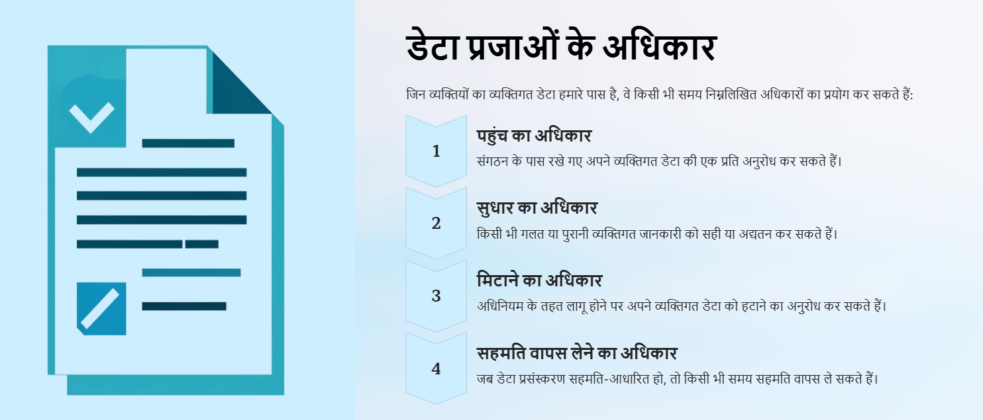
LNJ Bhilwara – Internal Training Material – IS & LM Cell – Version 1

Slide 18


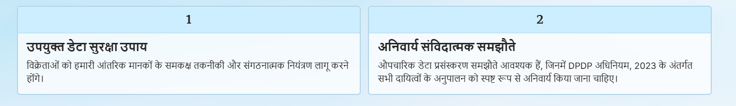
LNJ Bhilwara – Internal Training Material – IS & LM Cell – Version 1

Slide 19


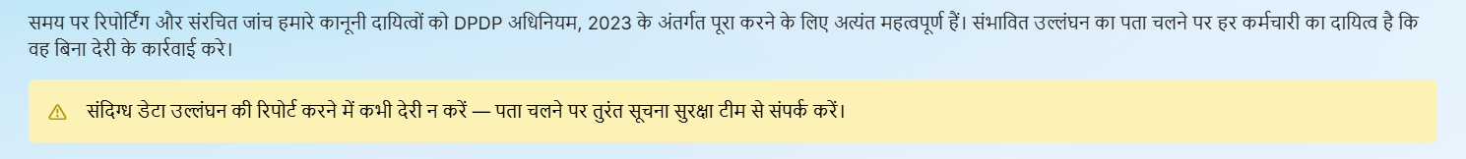
LNJ Bhilwara – Internal Training Material – IS & LM Cell – Version 1

Slide 20

LNJ Bhilwara – Internal Training Material – IS & LM Cell – Version 1

